Slide 1
CO2402 - Advanced Programming with C++
Week 15 - Classes and Class Diagrams
Gareth Bellaby

Slide 2
Topics
Class diagrams
Classes

Slide 3
Topic 1
Class diagrams

Slide 4
Class diagram
Unified Modelling Language (UML) is a set of diagrammatic techniques for modelling object oriented programs.
A class diagram is a way of depicting classes and the relationship between classes.
A class is represented by a box. The box is split into three.
The top part has the class name.
"Attributes" are the data members. They appear in the middle part.

Slide 5
Class diagram
"Methods" are the class methods (member functions). They appear in the bottom part.
Public is represented by the plus sign: +.
Private is represented by the minus sign: -.
Protected is represented by the hash sign: #.
A relationship between two classes is shown by a line. A line connects two classes in a relationship.
Relationships in UML are considered to be bi-directional unless an arrowhead is present.

Slide 6
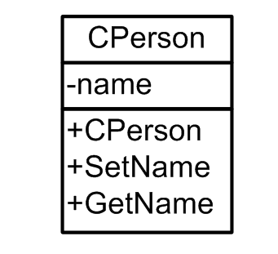
Example

Slide 7
Relationships
Association. A relationship.
Aggregation. Containment. The weak form of a containment relationship. A "has a" relationship. A class "has a", without implying ownership. The class will remain if the first class is destroyed. A lorry "has" pallets.
Composition. Containment. The strong form of a containment relationship. A "contains a" relationship, which implies ownership. A plane contains a propeller.
Generalisation. Inheritance. An "is-a" relationship.

Slide 8
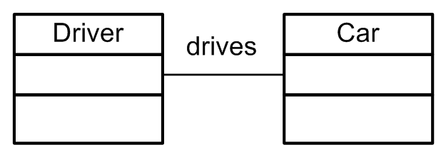
Association
Association - two classes in a relationship.
Association is when one class "knows about" another class.
A class can communicate with another class.
A class can be associated with another class.
Use a single line between the classes to show an association.
Label the association.

Slide 9
Aggregation
Aggregation. The weak form of a containment relationship. A class "has a" second class. Another way to phrase this is that a class "comprises other classes" or is "comprised of" other classes.
It is the weak form because the contained class will remain when the first class is destroyed.
Aggregation is shown using a diamond and an open arrowhead. The diamond is unfilled.
The diamond end points to the class doing the containing.

Slide 10
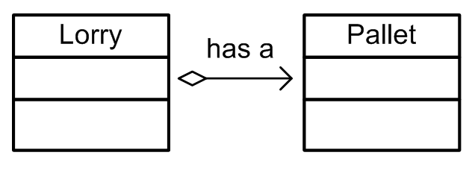
Aggregation
Unfilled diamond with an open arrowhead.
The class doing the containing has the diamond end.

Slide 11
Composition
Composition is the strong form of containment.
Composition is a strong form of aggregation. The one class wholly contains the other class. The lifetime of the second class is dependent upon the first. If the containing class is destroyed then the class that is being contained is destroyed.
Note that the containing class knows about the class being contained.
The class being contained does not know about the containing class.

Slide 12
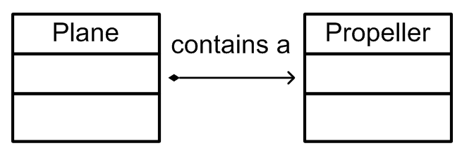
Composition
Composition is the strong form of containment.
Composition is shown using a filled diamond and an open arrowhead.

Slide 13
Association and Containment
The difference between association and containment can be minimal or obscure.
If you perceive the relationship as "containing" or "being composed of" then the relationship is containment.
If a class is just known to another class then this shows an association.
For example, a racing car has a driver. But the lifetime of each is independent of each another. It would seem odd to say that the racing car is composed of the driver. Therefore this would probably be association.
In practice the association and containment will be implemented in much the same way using C++.

Slide 14
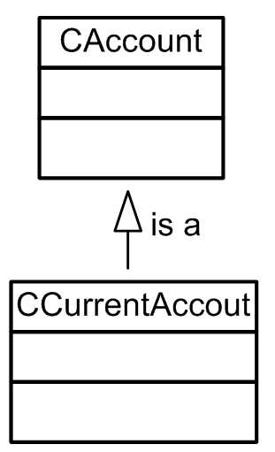
Generalisation
Generalisation is inheritance.
Inheritance is shown using a solid line and an arrowhead. The arrowhead is closed but unfilled.
A generalisation has the arrowhead pointing to the base class.

Slide 15
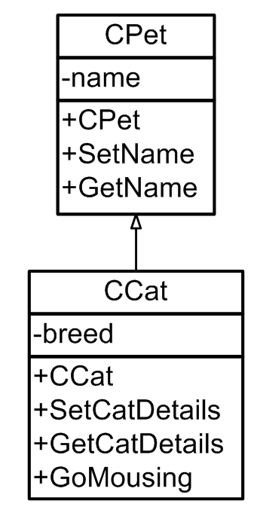
Generalisation
Inheritance

Slide 16
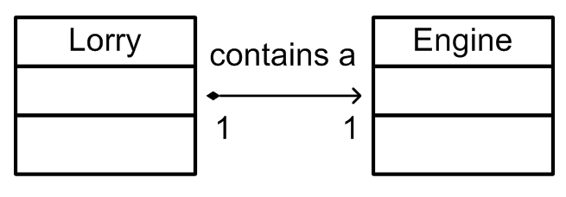
Multiplicity
You can specify the number of links between classes.
A lorry has 1 engine.
An engine only has 1 lorry.

Slide 17
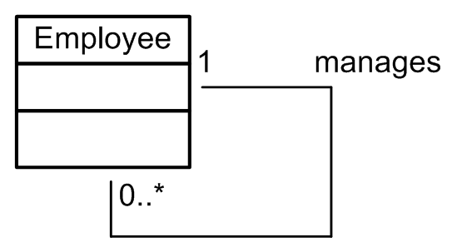
Recursion
A class can have a relationship with itself.
A class could "contain" itself. Recursion might be represented in this way.
An employee can manage other employees (but may manage none). An employee has 1 manager.

Slide 18
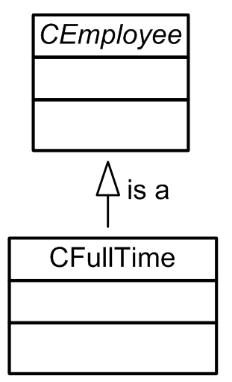
Abstract classes
Use the notation for generalisation (inheritance).
The name of the class is shown in italics.

Slide 19
Some observations
You do not need to show library classes.
You typically do not need to show functions.
Generally speaking I would suggest not showing helper classes.

Slide 20
Topic 2
Classes

Slide 21
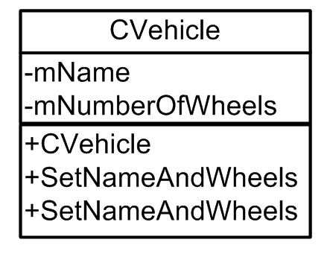
Vehicle
Use the keyword class.
I want a class called CVehicle.
The class stores the name (string) and number of wheels (integer) of the Vehicle.
Only three methods are required: a constructor, a setter and a getter.

Slide 22
Car
CVehicle is used as the base class to derive two new classes: CCar and CMotorBike.
The CCar class has the addition of a new data member: mNumberOfDoors (integer).
It will require a new constructor, a new getter and a new setter.

Slide 23
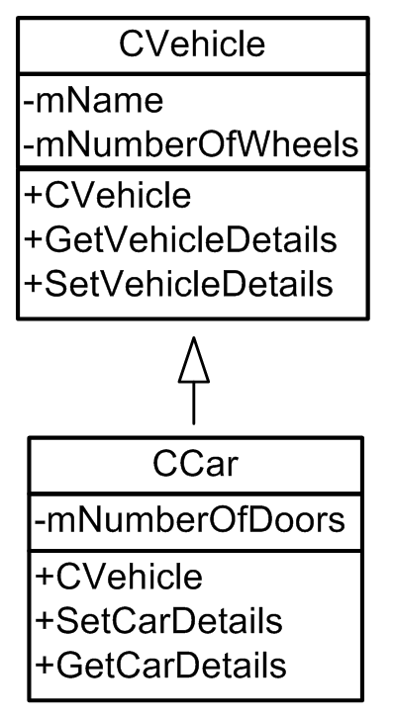
Car

Slide 24
MotorBike
The CMotorBike class has the addition of a new data member: cylinders.
CCylinders is a new class.
A motorbike has 1 to 4 cylinders.

Slide 25
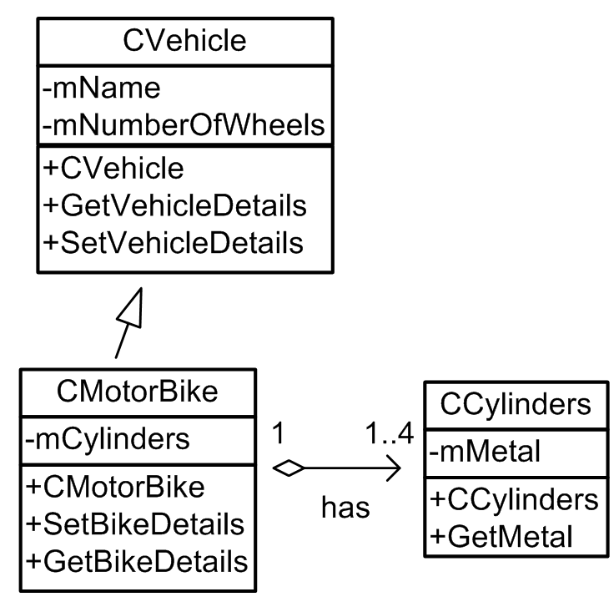
MotorBike

